Slide 1

Sprint 1 Demo
Helping Hand

Slide 2





Product Description
Communication tracking via social media and phone

Slide 3

Algorithm – Log Trust Increase
Max_trust
Max_compression_ratio (MaxCR)
Min_compression_ration (MinCR)
Compression_interval (CI)

Slide 4
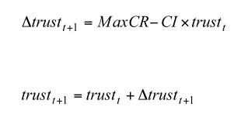
Algorithm

Slide 5
Algorithm – Our Plan
Weight by Social Media Platform
Count each interaction (likes, comments, DM's) and create average
Multiply number of interactions by social media weight
Looking into weighting social media platform or each individual interaction
Negative interaction occurance

Slide 6
Data
Social Media Data/API
Data Management
Most API focused on using their services
Some barriers to entry. (For business)
"Download my data" JSON/HTML formats
Facebook, Instagram, Snapchat, WhatsApp
Specify what data to download
Swifter: API able to search:
Tweets, Timelines, Messages, more
Controlled by Twitter Developer portal
User will download their data as JSON files
Pull user contacts to serve as master contact list
Ask user to match social media contacts with phone contacts

Slide 7
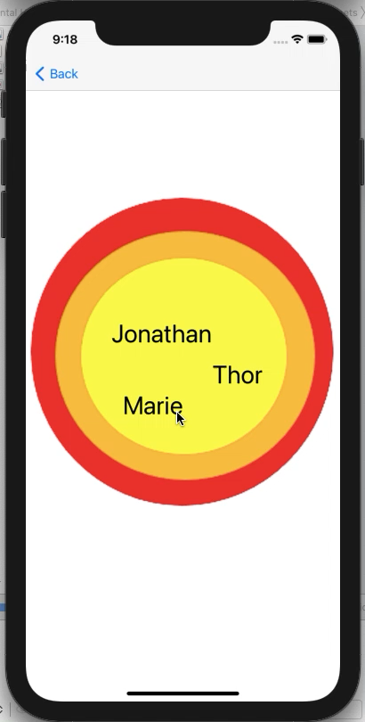
UI
ShowCircles View
Visually display the circles
Further improvements planned
Pop-Up
For contact matching
Further improvements planned

Slide 8
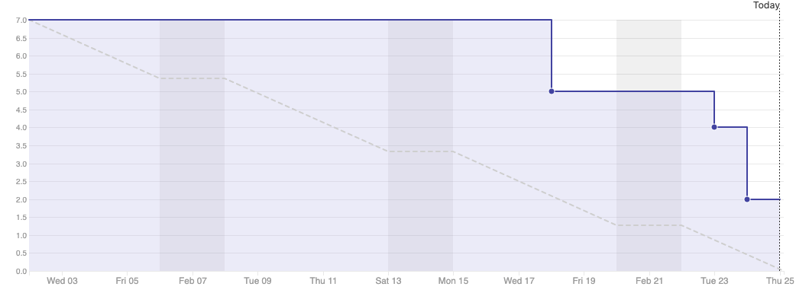
Burndown Chart

Slide 9
Documentation
Created "Sprints" within ZenHub to allow for closer tracking of what tasks are completed within certain timeframes
Completed edits for V1 of the SRS and SDS
These edits reflect our changes to the project direction
Future changes will include new software designs and more descriptive language of progress

Slide 10

What's Next
Algorithm
Negative interaction occurrence
Time waning and its significance
Xcode project
Work on UI views
Connect algorithm to the project
Data Collection
Parse user data from a JSON
Establish master contact file

Slide 11

Questions ?

